Slide 1
Boosting Algorithms in Machine Learning
Jayaraj P B
1

Slide 2
Outline
Decision Tree, Ensemble Learning, Bagging, Random Forest – Recap
Boosting
Adaboost
Gradient Boosting
Other Boosting Algorithms
1. XGBoost 2. Catboost 3. Light GBM
Stacking

Slide 3
Decision trees
Non-linear classifier
Easy to use
Easy to interpret
Susceptible to overfitting but can be
avoided.

Slide 4
Decision tree structure

Slide 5
Disadvantages of the Decision Tree
The decision tree contains lots of layers, which makes it complex.
It may have an overfitting issue, which can be resolved using the Random Forest algorithm.
For more class labels, the computational complexity of the decision tree may increase.

Slide 6
wisdom of the crowd
Suppose you ask a complex question to thousands of random people, then aggregate their answers. In many cases you will find that this aggregated answer is better than an expert’s answer. This is called the wisdom of the crowd.
Similarly, if you aggregate the predictions of a group of predictors (such as classifiers or regressors), you will often get better predictions than with the best individual predictor. A group of predictors is called an ensemble; thus, this technique is called Ensemble Learning

Slide 7
Ensemble Learning
Ensemble simply means combining multiple models. Thus a collection of models is used to make predictions rather than an individual model.
Ensemble uses two types of methods:
Bagging
It creates a different training subset from sample training data with replacement & the final output is based on majority voting. For example, Random Forest.
Boosting
It combines weak learners into strong learners by creating sequential models such that the final model has the highest accuracy. For example, ADA BOOST, XG BOOST.

Slide 8
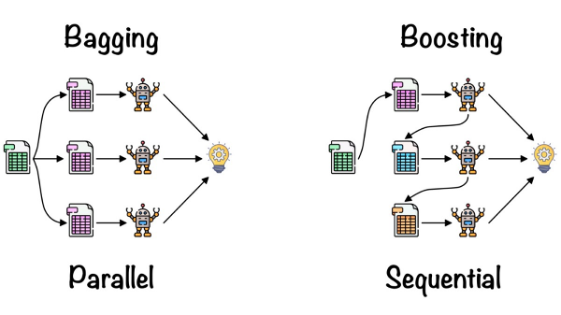
Bagging Vs Boosting

Slide 9
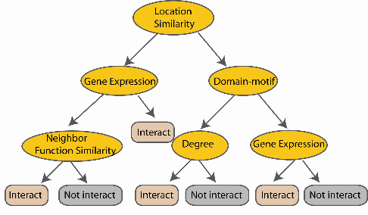
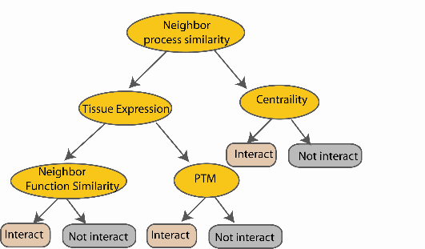
Random Forest Classifier
M features
N examples
Take he majority vote
....…
....…
Notes:
Finally the given an input data the decision is made as follows given an input data,

Slide 10
Boosting
Boosting is an ensemble modelling technique that attempts to build a strong classifier from the number of weak classifiers.
It is done by building a model by using weak models in series.
Firstly, a model is built from the training data.
Then the second model is built which tries to correct the errors present in the first model.
This procedure is continued and models are added until either the complete training data set is predicted correctly or the maximum number of models are added.

Slide 11
Boosting
Boosting (originally called hypothesis boosting) refers to any Ensemble method that can combine several weak learners into a strong learner.
The general idea of most boosting methods is to train predictors sequentially, each trying to correct its predecessor.
There are many boosting methods available, but by far the most popular are
AdaBoost (short for Adaptive Boosting) &
Gradient Boosting.

Slide 12
S.NO | Bagging | Boosting
1. | The simplest way of combining predictions that belong to the same type. | A way of combining predictions that belong to the different types.
2. | Aim to decrease variance, not bias. | Aim to decrease bias, not variance.
3. | Each model receives equal weight. | Models are weighted according to their performance.
4. | Each model is built independently. | New models are influenced by the performance of previously built models.
5. | Different training data subsets are selected using row sampling with replacement and random sampling methods from the entire training dataset. | Every new subset contains the elements that were misclassified by previous models.
6. | Bagging tries to solve the over-fitting problem. | Boosting tries to reduce bias.
7. | If the classifier is unstable (high variance), then apply bagging. | If the classifier is stable and simple (high bias) then apply boosting.
8. | In this base classifiers are trained parallelly. | In this base classifiers are trained sequentially.
9 | Example: The Random forest model uses Bagging. | Example: The AdaBoost uses Boosting techniques

Slide 13
Types of Boosting Algorithms
AdaBoost (Adaptive Boosting)
Gradient Boosting
XGBoost
CatBoost
Light GBM
GentleBoost
LPBoost
BrownBoost

Slide 14
AdaBoost
One way for a new predictor to correct its predecessor is to pay a bit more attention to the training instances that the predecessor underfitted.
This results in new predictors focusing more and more on the hard cases.
This is the technique used by Ada Boost.
For example, to build an AdaBoost classifier, a first base classifier (such as a Decision Tree) is trained and used to make predictions on the training set.

Slide 15
AdaBoost Continue…..
The relative weight of misclassified training instances is then increased.
A second classifier is trained using the updated weights and again it makes predictions on the training set, weights are updated, and so on
As you can see, this sequential learning technique has some similarities with Gradient Descent, except that instead of tweaking a single predictor’s parameters to minimize a cost function, AdaBoost adds predictors to the ensemble, gradually making it better.

Slide 16
AdaBoost sequential training with instance weight updates

Slide 17
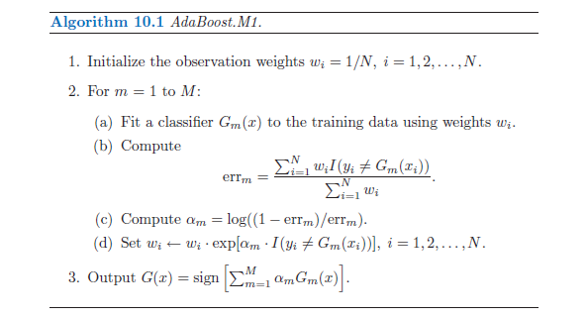

Slide 18
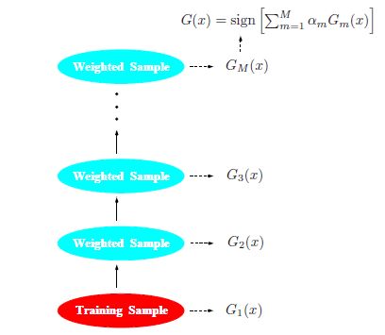
Schematic of AdaBoost. Classifiers are trained on weighted versions of the dataset, and then combined to produce a final prediction.

Slide 19
Once all predictors are trained, the ensemble makes predictions very much like bagging or pasting, except that predictors have different weights depending on their overall accuracy on the weighted training set.
There is one important drawback to this sequential learning technique: it cannot be parallelized (or only partially), since each predictor can only be trained after the previous predictor has been trained and evaluated.
As a result, it does not scale as well as bagging or pasting.

Slide 20
Scikit-Learn actually uses a multiclass version of AdaBoost called SAMME (which stands for Stagewise Additive Modeling using a Multiclass Exponential loss function). When there are just two classes, SAMME is equivalent to AdaBoost.
If your AdaBoost ensemble is overfitting the training set, you can try reducing the number of estimators or more strongly regularizing the base estimator

Slide 21
The steps taken in AdaBoost.
Build a model and make predictions.
Assign higher weights to miss-classified points.
Build next model.
Repeat steps 3 and 4.
Make a final model using the weighted average of individual models.

Slide 22
Key Takeaways
Adaboost is an ensemble learning technique used to improve the predictive accuracy of any given model by combining multiple “weak” learners.
Adaboost works by weighting incorrectly classified instances more heavily so that the subsequent weak learners focus more on the difficult cases.
It is adaptive in the sense that subsequent weak learners are tweaked in favour of those instances misclassified by previous classifiers.
Adaboost is simple to implement and versatile.
It is highly effective in binary classification problems and can be used to solve multi-class classification problems.
Adaboost is not suitable for noisy data and is sensitive to outliers.

Slide 23
Gradient Boosting
As like AdaBoost, Gradient Boosting works by sequentially adding predictors to an ensemble, each one correcting its predecessor.
However, instead of tweaking the instance weights at every iteration like AdaBoost does, this method tries to fit the new predictor to the residual errors made by the previous predictor.
It aims to improve overall predictive performance by optimizing the model’s weights based on the errors of previous iterations, gradually reducing prediction errors and enhancing the model’s accuracy.

Slide 24
The main idea behind this algorithm is to build models sequentially and these subsequent models try to reduce the errors of the previous model.
But how do we do that? How do we reduce the error?
This is done by building a new model on the errors or residuals of the previous model

Slide 25
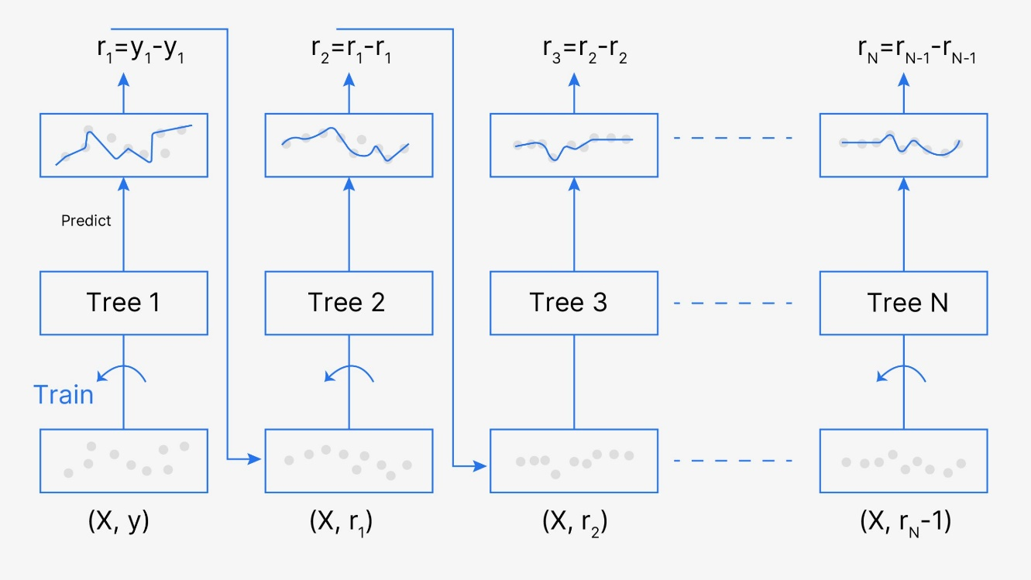

Slide 26
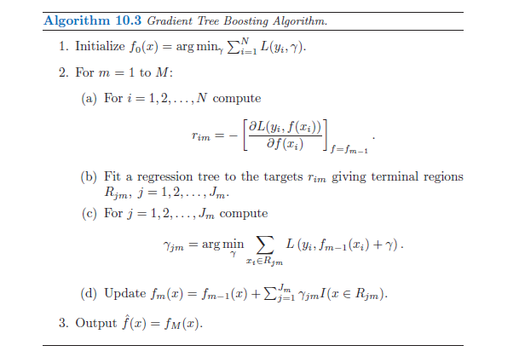

Slide 27
Gradient Boosting
When the target column is continuous, we use Gradient Boosting Regressor whereas when it is a classification problem, we use Gradient Boosting Classifier.
The only difference between the two is the “Loss function”. The objective here is to minimize this loss function by adding weak learners using gradient descent.
Since it is based on loss function hence for regression problems, we’ll have different loss functions like Mean squared error (MSE) and for classification, we will have different for e.g log-likelihood(BCE).

Slide 28
How Gradient Boosting Works
Gradient boosting involves three elements:
A loss function to be optimized.
A weak learner to make predictions.
An additive model to add weak learners to minimize the loss function.

Slide 29
XG Boost
XGBoost is also a boosting machine learning algorithm, which is the next version on top of the gradient boosting algorithm.
The full name of the XGBoost algorithm is the eXtreme Gradient Boosting algorithm, as the name suggests it is an extreme version of the previous gradient boosting algorithm.
The main difference between GradientBoosting is XGBoost is that XGbost uses a regularization technique in it. In simple words, it is a regularized form of the existing gradient-boosting algorithm.
Due to this, XGBoost performs better than a normal gradient boosting algorithm and that is why it is much faster than that also.

Slide 30
CatBoost
“CatBoost” name comes from two words “Category” and “Boosting”. This algorithm works well with multiple Categories of data, such as audio, text, image including historical data.
“Boost” comes from a gradient boosting machine learning algorithm as this library is based on a gradient boosting library.
It can also return very good results with relatively less data, unlike DL models that need to learn from a massive amount of data.
CatBoost uses a combination of ordered boosting, random permutations and gradient-based optimization to achieve high performance.

Slide 31
LightGBM
A gradient boosting solution for tree-based models called LightGBM attempts to be quicker and more effective than previous frameworks.
Guolin Ke and his group at Microsoft Research Asia created it in 2017.
The acronym LightGBM stands for “Light Gradient Boosting Machine,” where “light” alludes to the machine’s fast speed and little resource use.
Gradient-based One-Side Sampling (GOSS) and Exclusive Feature Bundling (EFB) are two cutting-edge methods that LightGBM employs to enhance the tree learning procedure.

Slide 32
Stacking
It is based on a simple idea: instead of using trivial functions (such as hard voting) to aggregate the predictions of all predictors in an ensemble, why don’t we train a model to perform this aggregation?
Figure shows (next slide) such an ensemble performing a regression task on a new instance.
Each of the bottom three predictors predicts a different value (3.1, 2.7, and 2.9), and then the final predictor (called a blender, or a meta learner) takes these predictions as inputs and makes the final prediction (3.0).

Slide 33
Aggregating predictions using a blending predictor

Slide 34
Training the first layer
To train the blender, a common approach is to use a hold-out set

Slide 35
Training the blender

Slide 36
Predictions in a multilayer stacking ensemble

Slide 37
portions for MID Exam
KNN, Bias, Variance, Performance Evaluation of Model, VC Dimension, Linear Regression, MLE, MLE & MSE, MLE & BCE, Decision Trees, Bagging, Random Forest, Boosting

